Slide 1
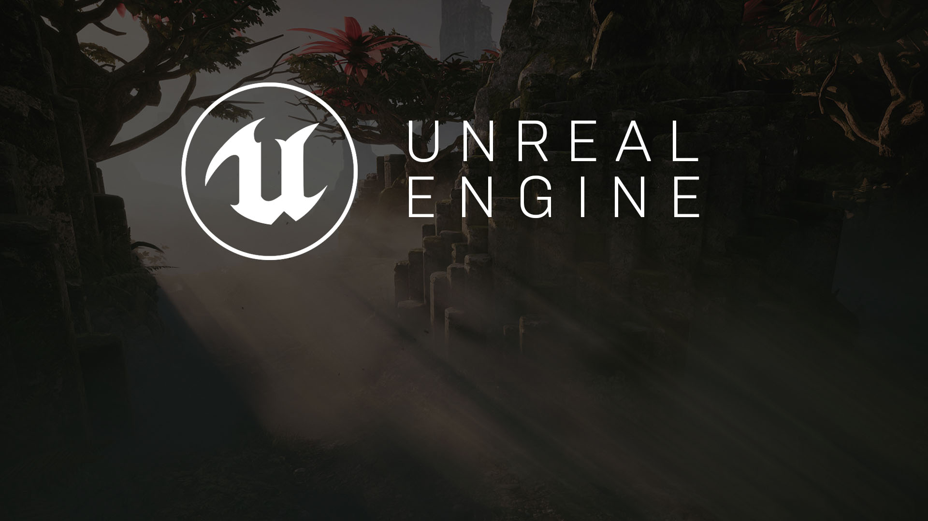
Optimizing and Debugging
Identifying and Planning for Issues

Slide 2
Planning your art budget
A Paramount Task when Beginning a Project

Slide 3

Many people view project optimization as the final step in a project. From the outside, it’s common to view the process of game development as being one where you design, build, and fix; however, this is not the case. The best optimizations often start with the work you do at the very beginning of your project.
Once a project begins, a wide range of art “budgets” must be determined. These are drawn from a variety of factors, including but not limited to the following:
Target platform(s)
Expected development time
Art style
Multiplayer versus single player
Lighting model
Player counts
These factors often go into the process of developing a vertical slice, which is used as a core piece of project planning.
Optimizations should begin when your project begins.

Slide 4

?
Determining Your Target Platforms
Knowing your target platform or platforms is important in identifying your minimum specifications, which serve as a firm baseline for testing and optimization.
Target platform knowledge is also important in identifying features that will be used in the project; for instance, mobile VR will generally be unable to support much transparency, and low-end PCs will not be able to reasonably support Planar Reflections.

Slide 5

The cost of an art style
Different art styles create different amounts of overhead. Establishing the style early in a project means that these overheads can be more readily quantified.
Realistic (A Boy and His Kite)
Realistic projects typically involve high texture memory usage.
Hyper-realistic (Paragon and Infiltrator)
Hyper-realistic projects also involve high texture memory usage; however, the amount used can be minimized through employing detail textures and other techniques.
Cartoon (Fortnite)
Cartoon projects have minimal normal maps, which reduces texture usage, though they often involve more frequent usage of vertex animations and custom post process effects.
.

Slide 6
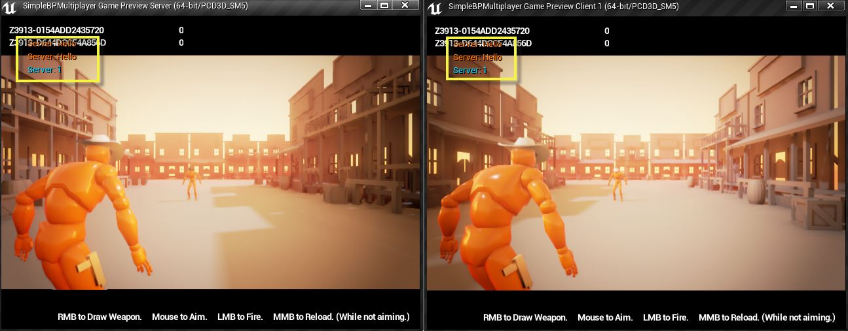
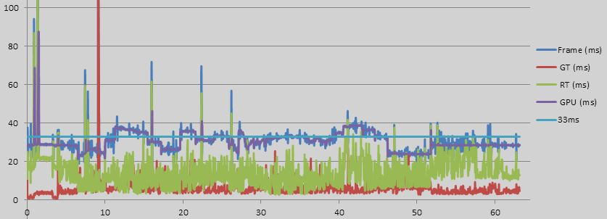
Multiplayer vs. Single-player optimization
Multiplayer games can require a more standardized baseline for visual requirements since they rely heavily on equality in play.
One of the most common optimizations in foliage-heavy games is to disable grass on low-spec machines. In a multiplayer game, this can result in players with high-spec machines laying prone in grass for cover while those with low-spec machines see a person completely out in the open with no grass in sight.
Consequently, a game that is multiplayer may affect your minimum specifications, or it may affect your level and environmental design decisions.

Slide 7
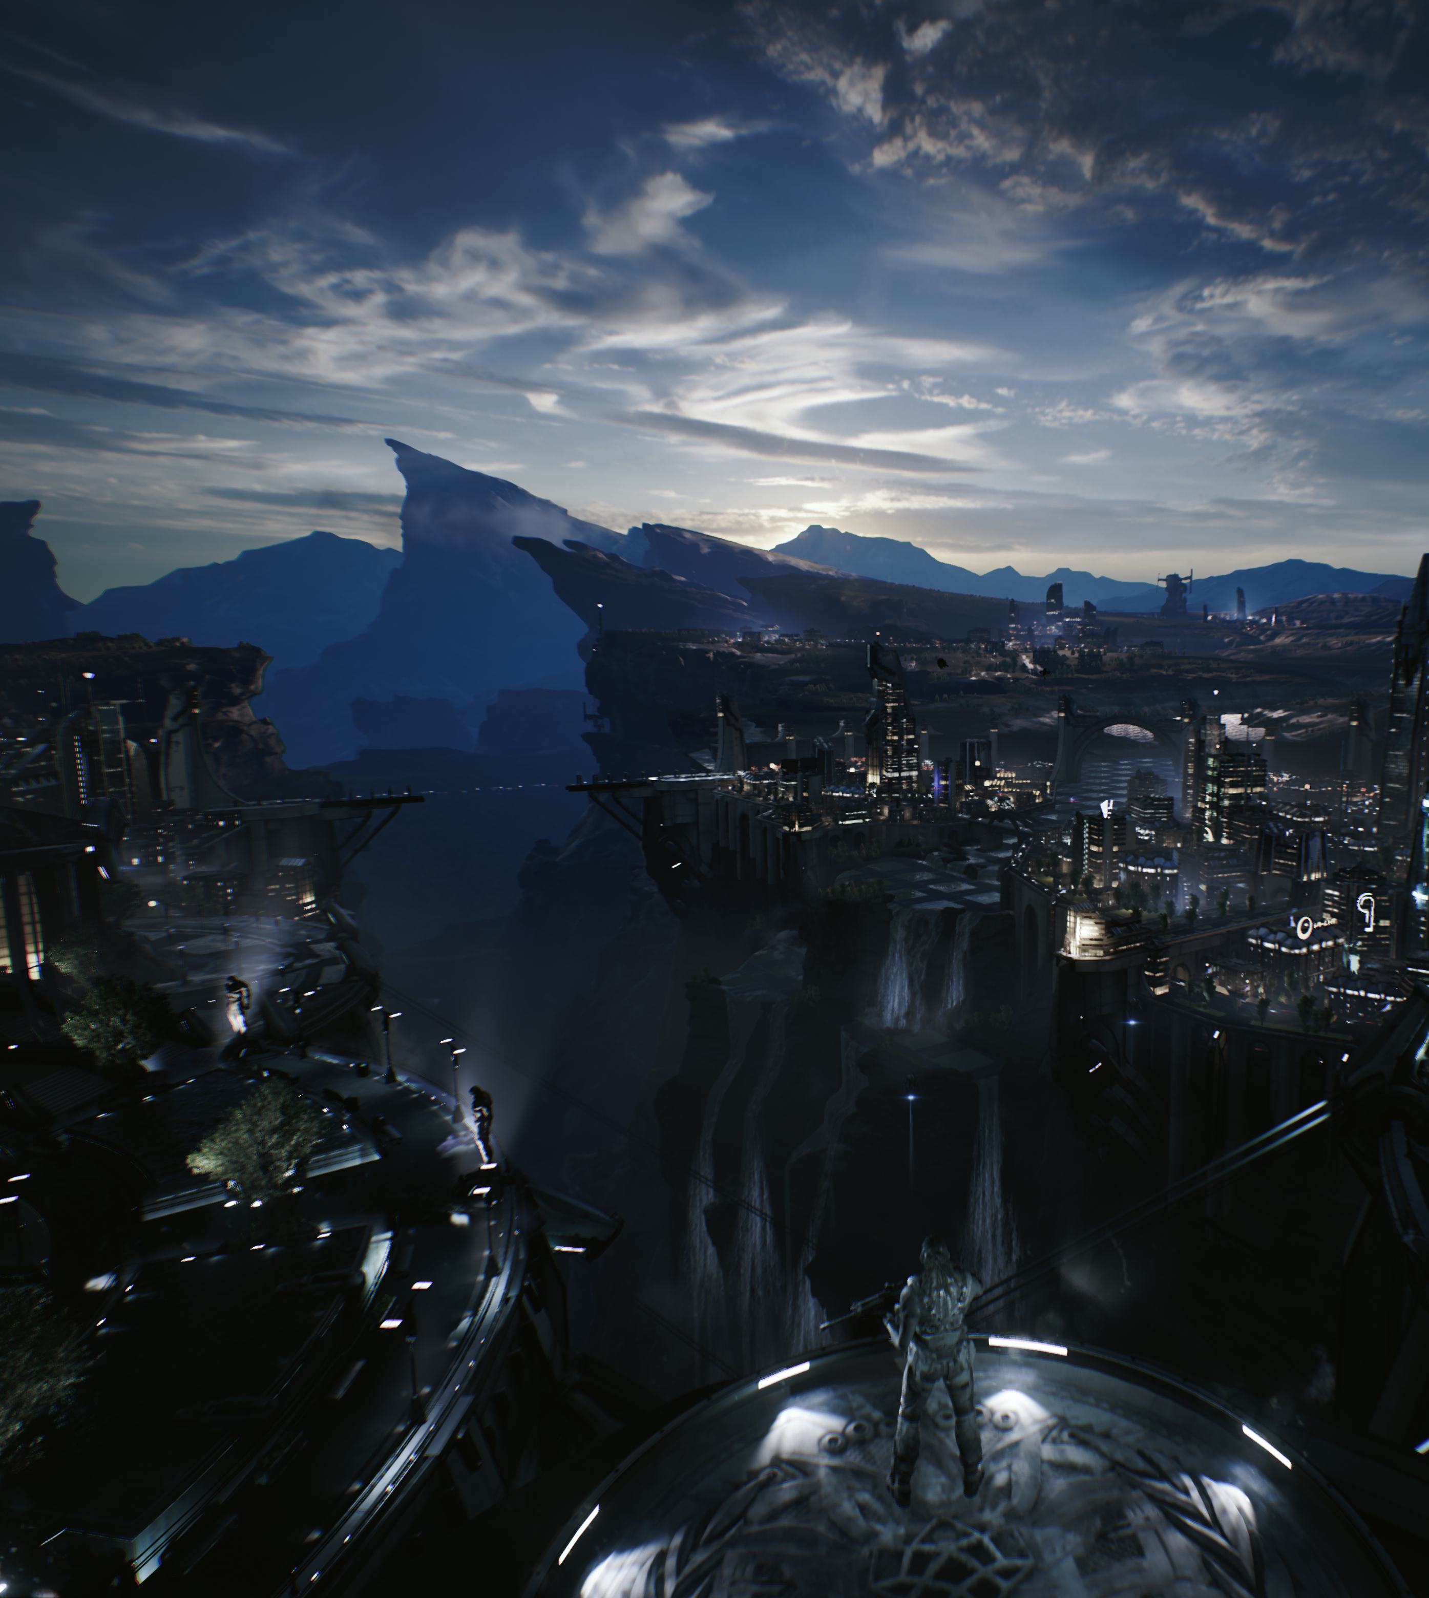
Lighting Model
The lighting model selected for a project vastly affects the project’s performance requirements. A project that incorporates different times of day may require fully dynamic lighting (expensive), or the effects may be achievable with static lighting scenarios (inexpensive).
Since lighting can incur substantial overhead, identifying the most suitable lighting method for a project is crucial in developing an accurate Vertical Slice and meaningful art budget.

Slide 8
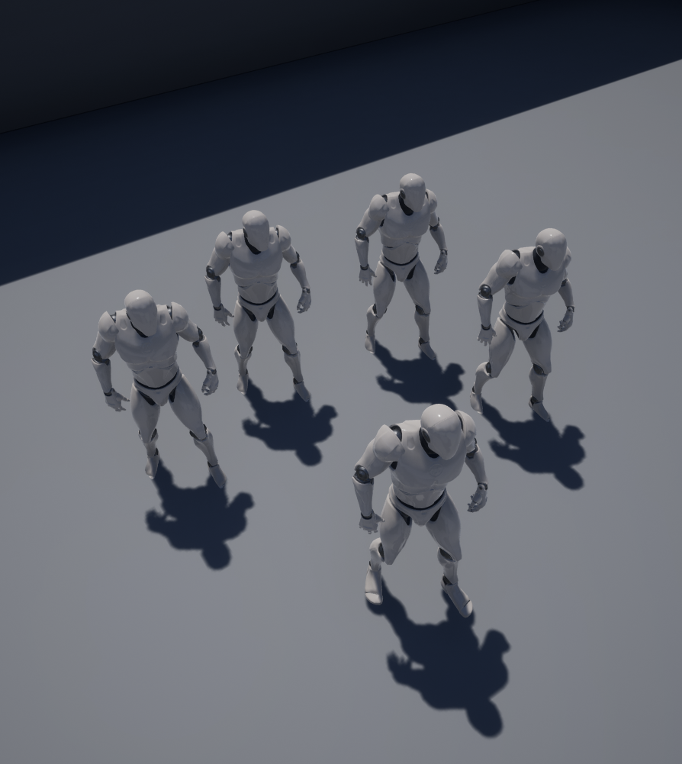
Player Counts
If a game has a variable player count, the worst-case scenario needs to be taken into account when determining the budgets for characters.
The scenario may be altered by looking at player characters versus non-player characters; however, the budget of an extra 5,000 polys per character when 32 enemies appear on screen at once, complete with their own animations and effects, can certainly be nontrivial.

Slide 9
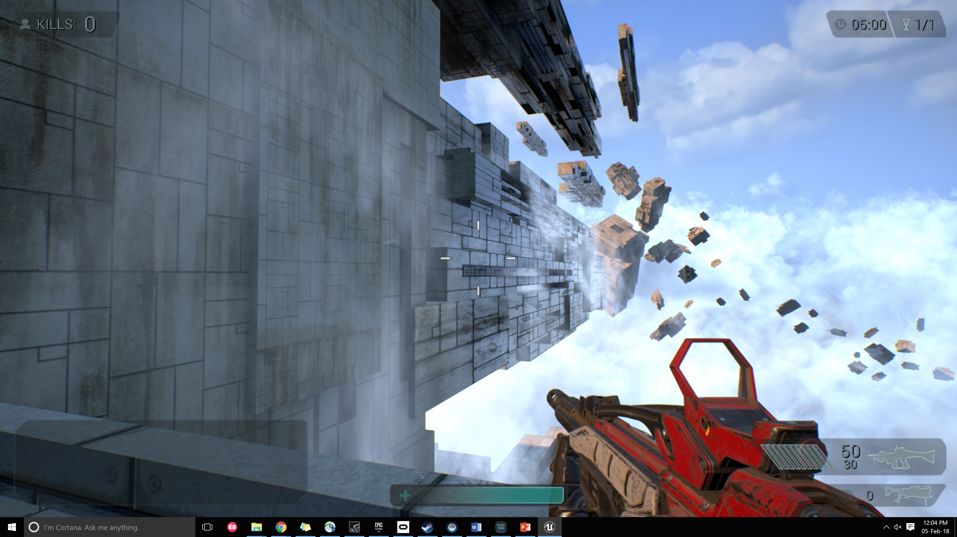
Vertical Slice
A vertical slice is a single contained scene or level that is produced as a point of reference for developing the rest of the game. While in the case of optimizations it’s used in the context of art, it can also be used to capture the general feel of gameplay.

Slide 10
Art Budgets
Art budgets are documented standards against which to develop assets. Their content will vary across projects, but they typically contain the following:
Asset and scene poly counts
Bone counts for characters
Maximum texture sizes among asset types
Draw calls
Post processing standards
Target frame times

Slide 11
Optimizations
What to Fix and How

Slide 12
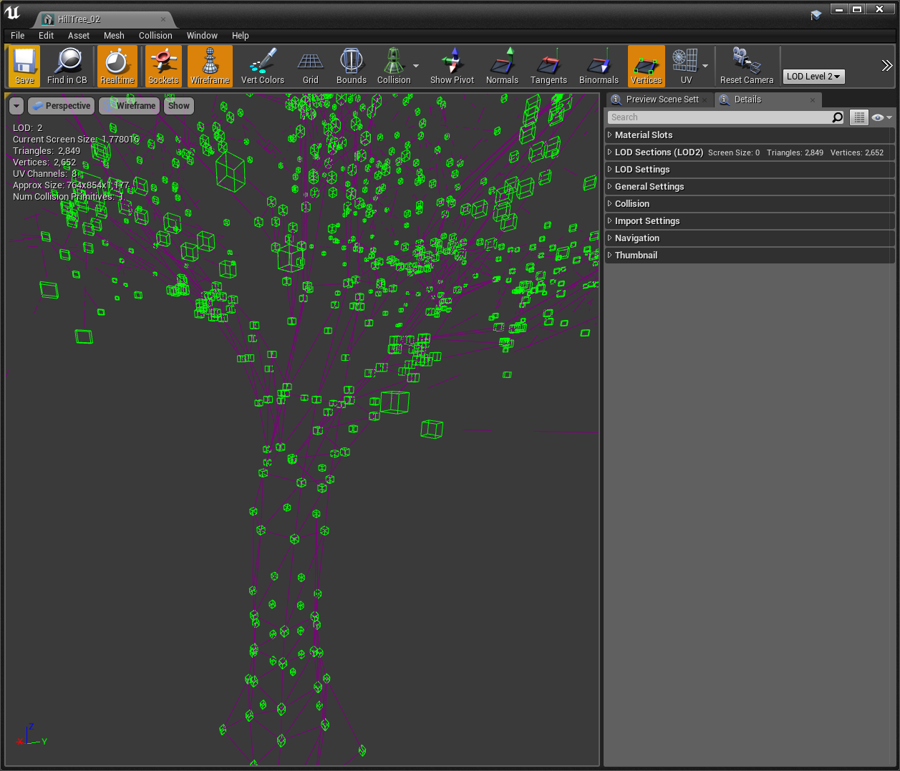
Vertex counts
The number of vertices in a model not only affects the amount of overhead in rendering your base scene but also increases the overhead from any instructions being performed in your vertex shader.
Vertex counts are increased for seams within every UV set added to a model, so be wary of adding unnecessary UV sets.

Slide 13
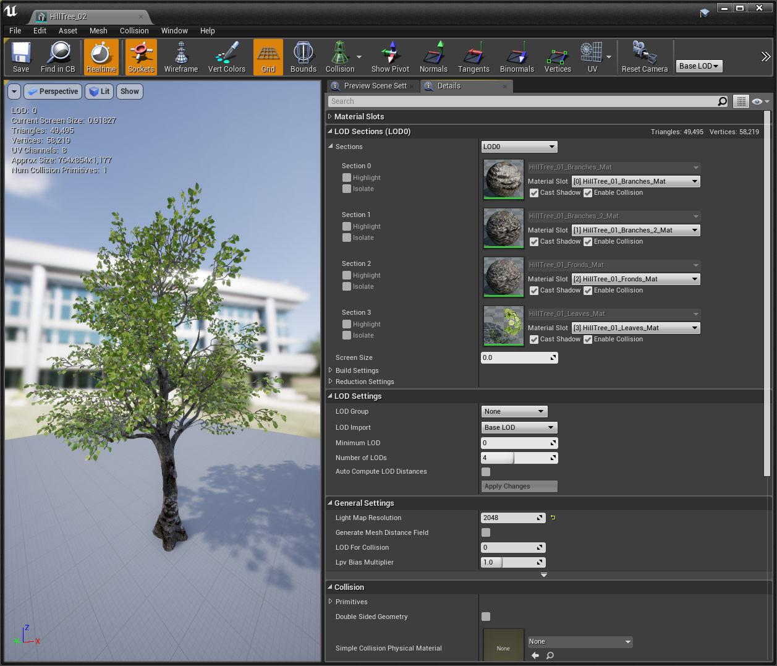
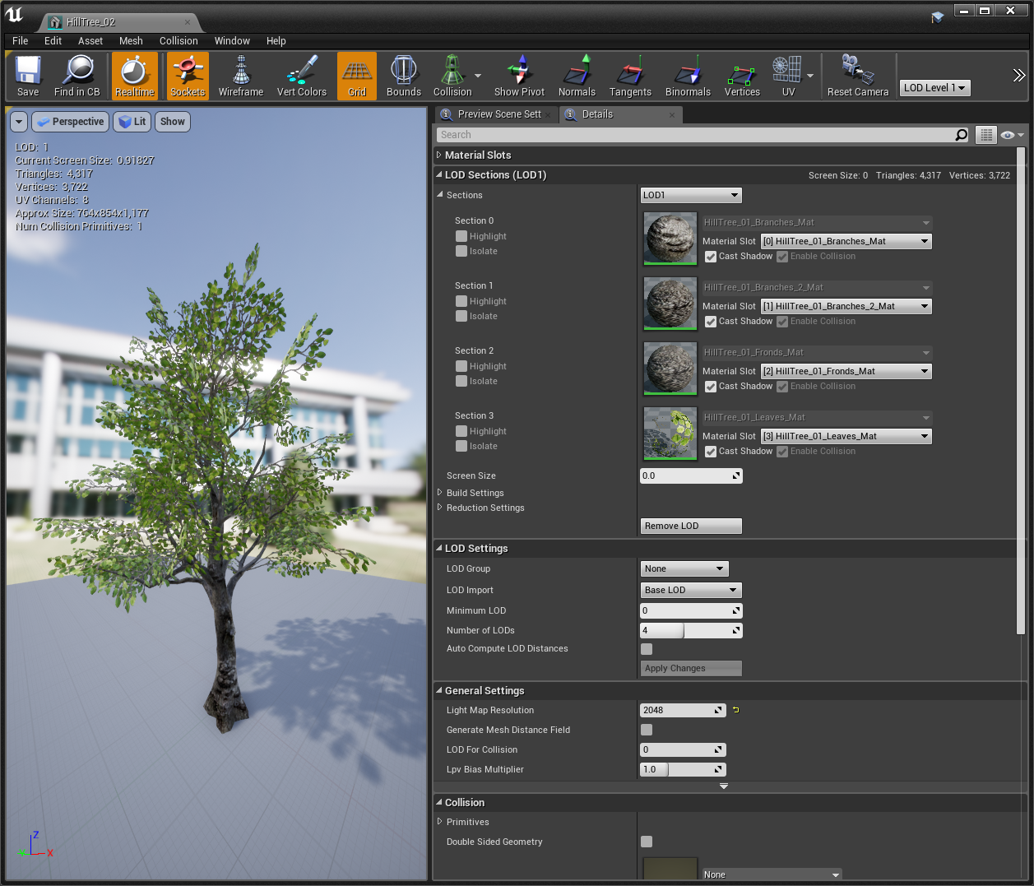
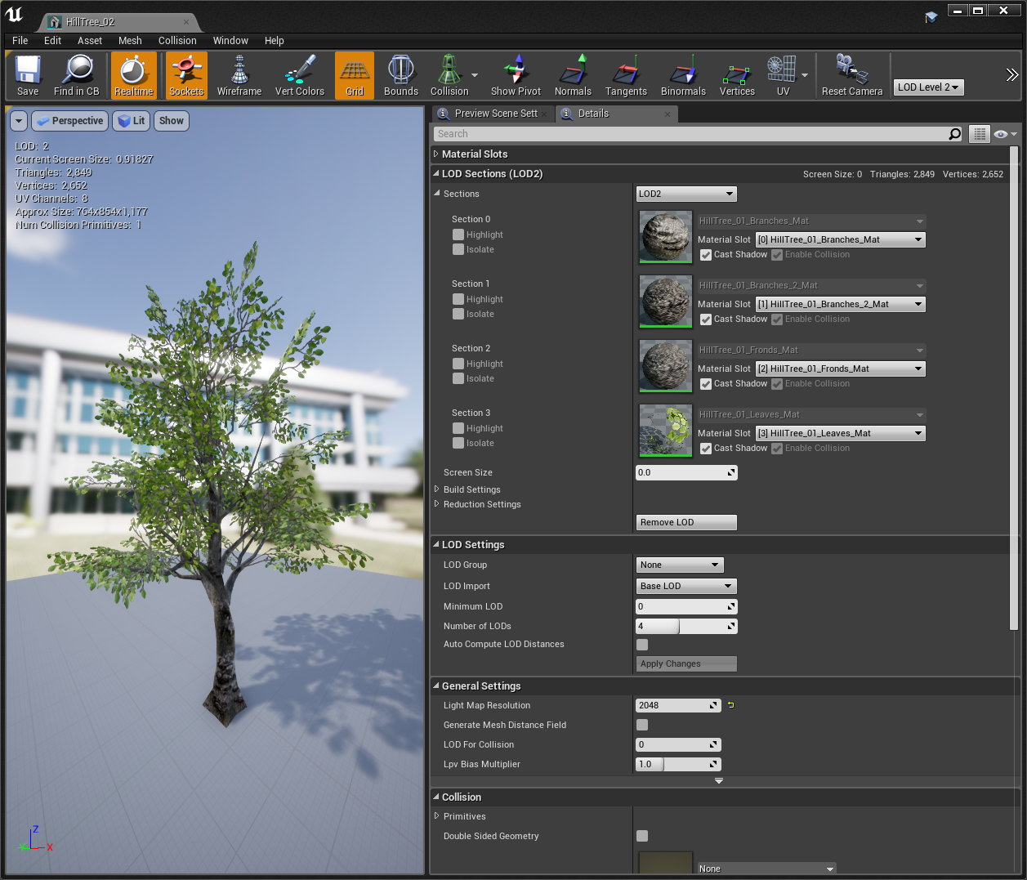
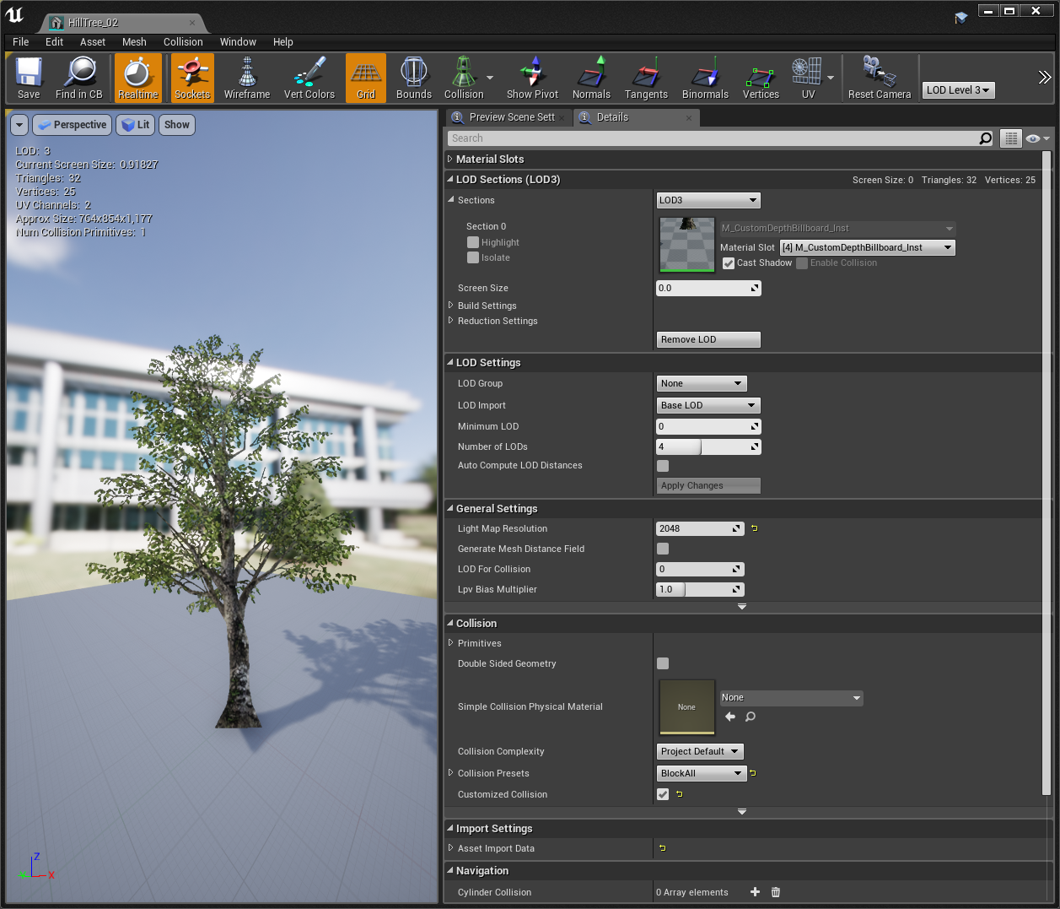
LODs
When a player is up close to a Static Mesh you have placed in your level, you want the mesh to look very detailed and typically want a high number of vertices within the model. However, you do not need that mesh to be very detailed and complex once the player moves far away from the mesh. There is no point in having a complex and detailed mesh if it is only taking up a few pixels on the screen and the player can barely see it. The mesh needs to be detailed only when the player is up close to the mesh and can see it clearly. In UE4, you can place a mesh in your level that switches to a less complex mesh as the player moves away from it in order to make your level perform better. You can do this through the use of Level of Details, or LODs.

Slide 14
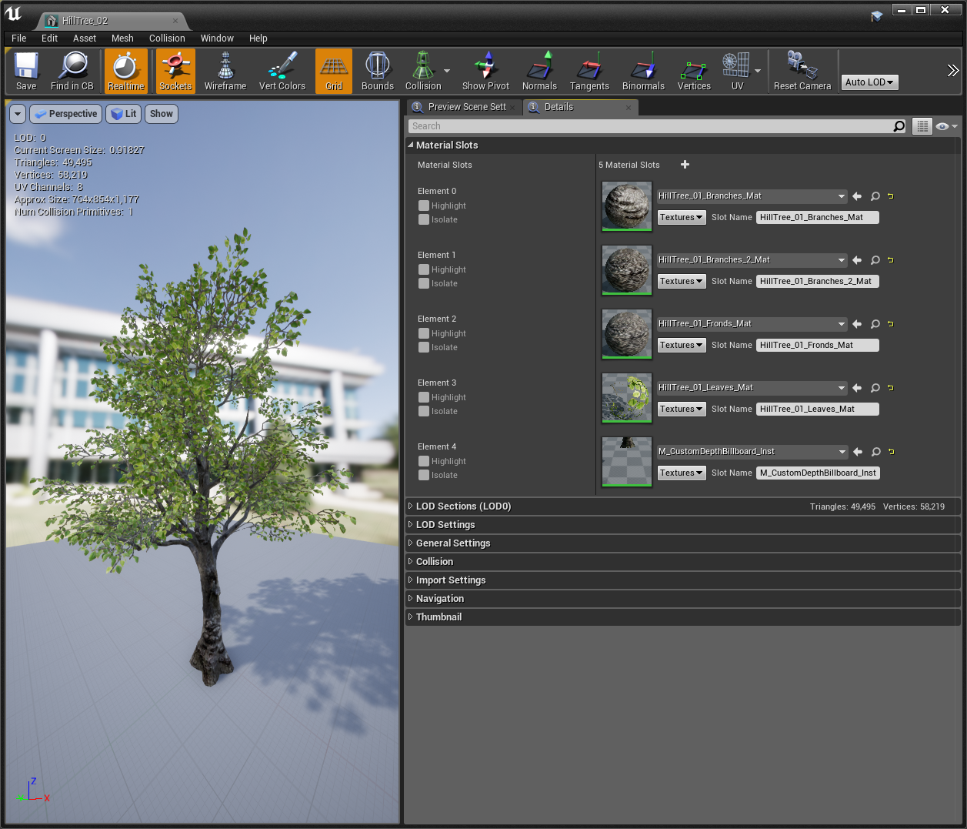
Material Counts
Each Static and Skeletal Mesh in a scene is rendered once per Material Slot. This means that if a mesh has unnecessary extra materials that could have been optimized, the entire mesh will be re-rendered for each of those sections.
Adding draw calls adds overhead to the CPU and GPU and should be avoided where possible. For this reason, the number of materials that should be applied to characters, weapons, and environmental assets should be established early and deviated from only where necessary.

Slide 15
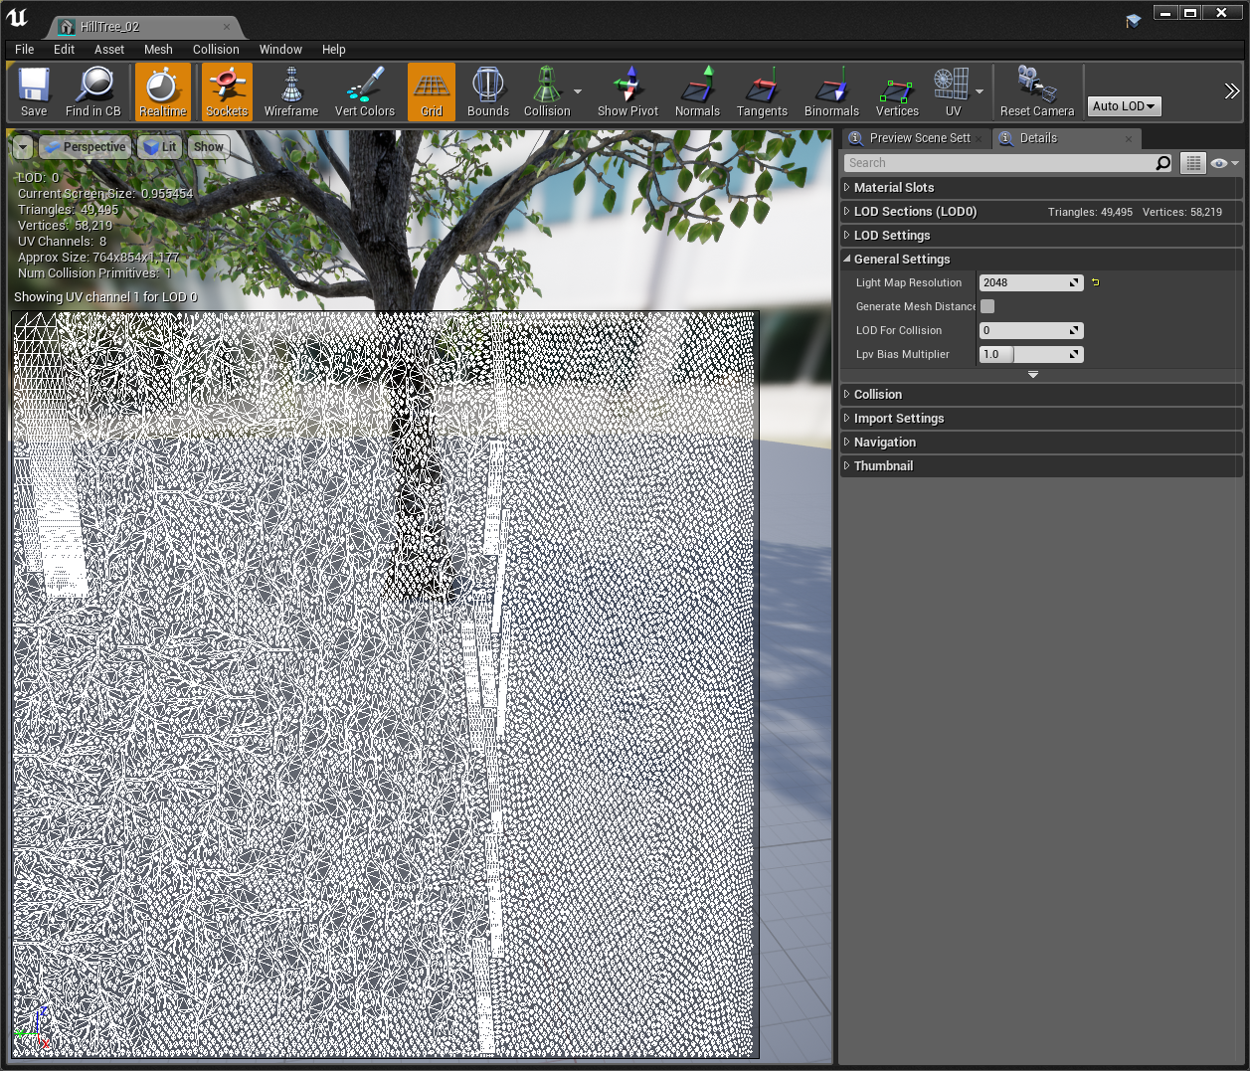
Lightmap Resolutions
In a static lighting scenario, every asset has lighting data baked into it via its lightmap. When each asset across a scene is added up, their respective lightmaps can account for a significant amount of memory.
3D assets may be found to have high lightmap resolutions due to wasted space in the Lightmap UV or simply because the developer didn’t tweak the value from the default values. These assets can be located through either the Statistics Window or the Lightmap Density view mode.

Slide 16
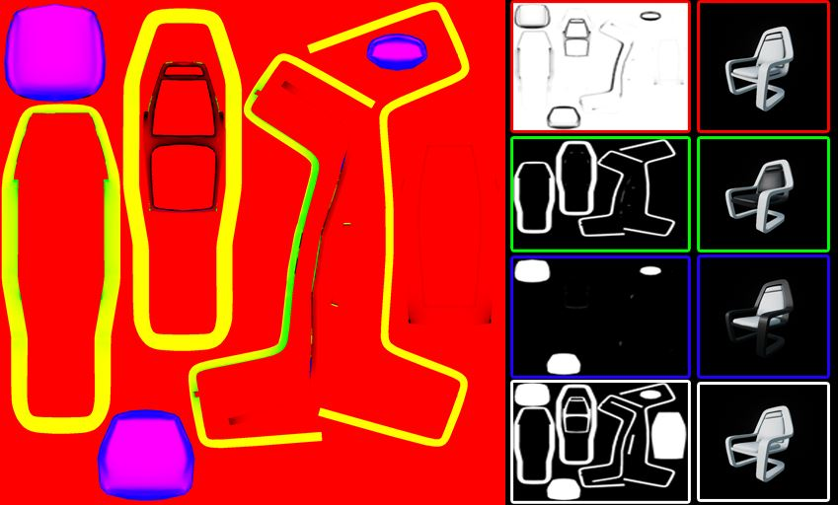
Texture Packing
Often assets require textures that contain single channels of data. For instance, a character might require Roughness, Metallic, Scratch, and Grime masks. A developer can save memory by packing all of these into a single texture, with each being stored in the Red, Green, Blue, or Alpha channel. Be aware that any texture stored in the green channel will have slightly higher quality.
When planning a project’s asset pipeline, it’s important to look for opportunities for texture packing and to establish which channel will be used for what across every similar asset.

Slide 17
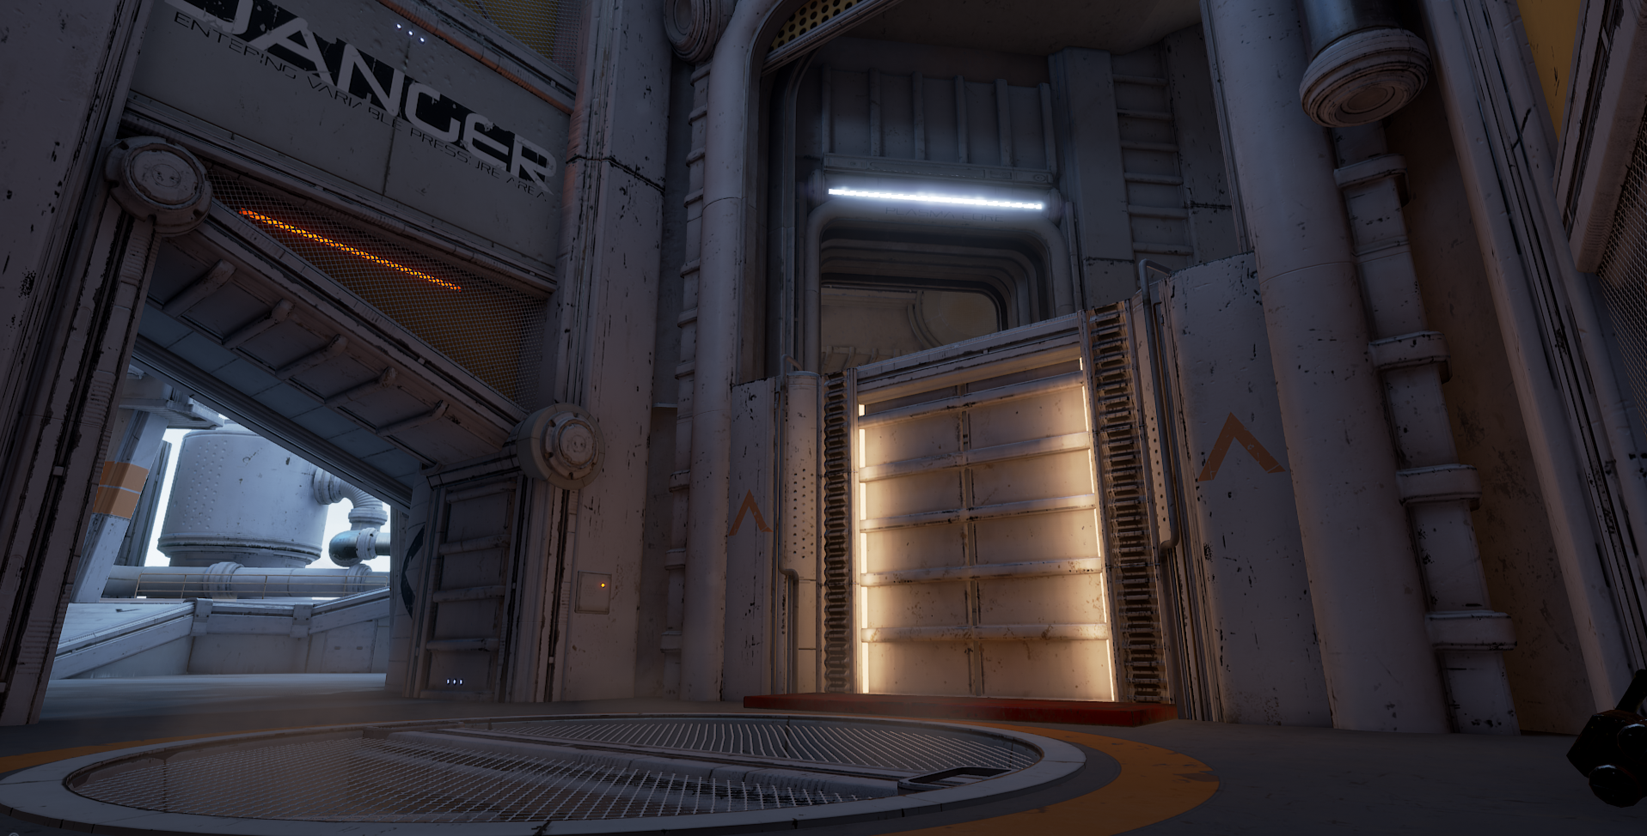
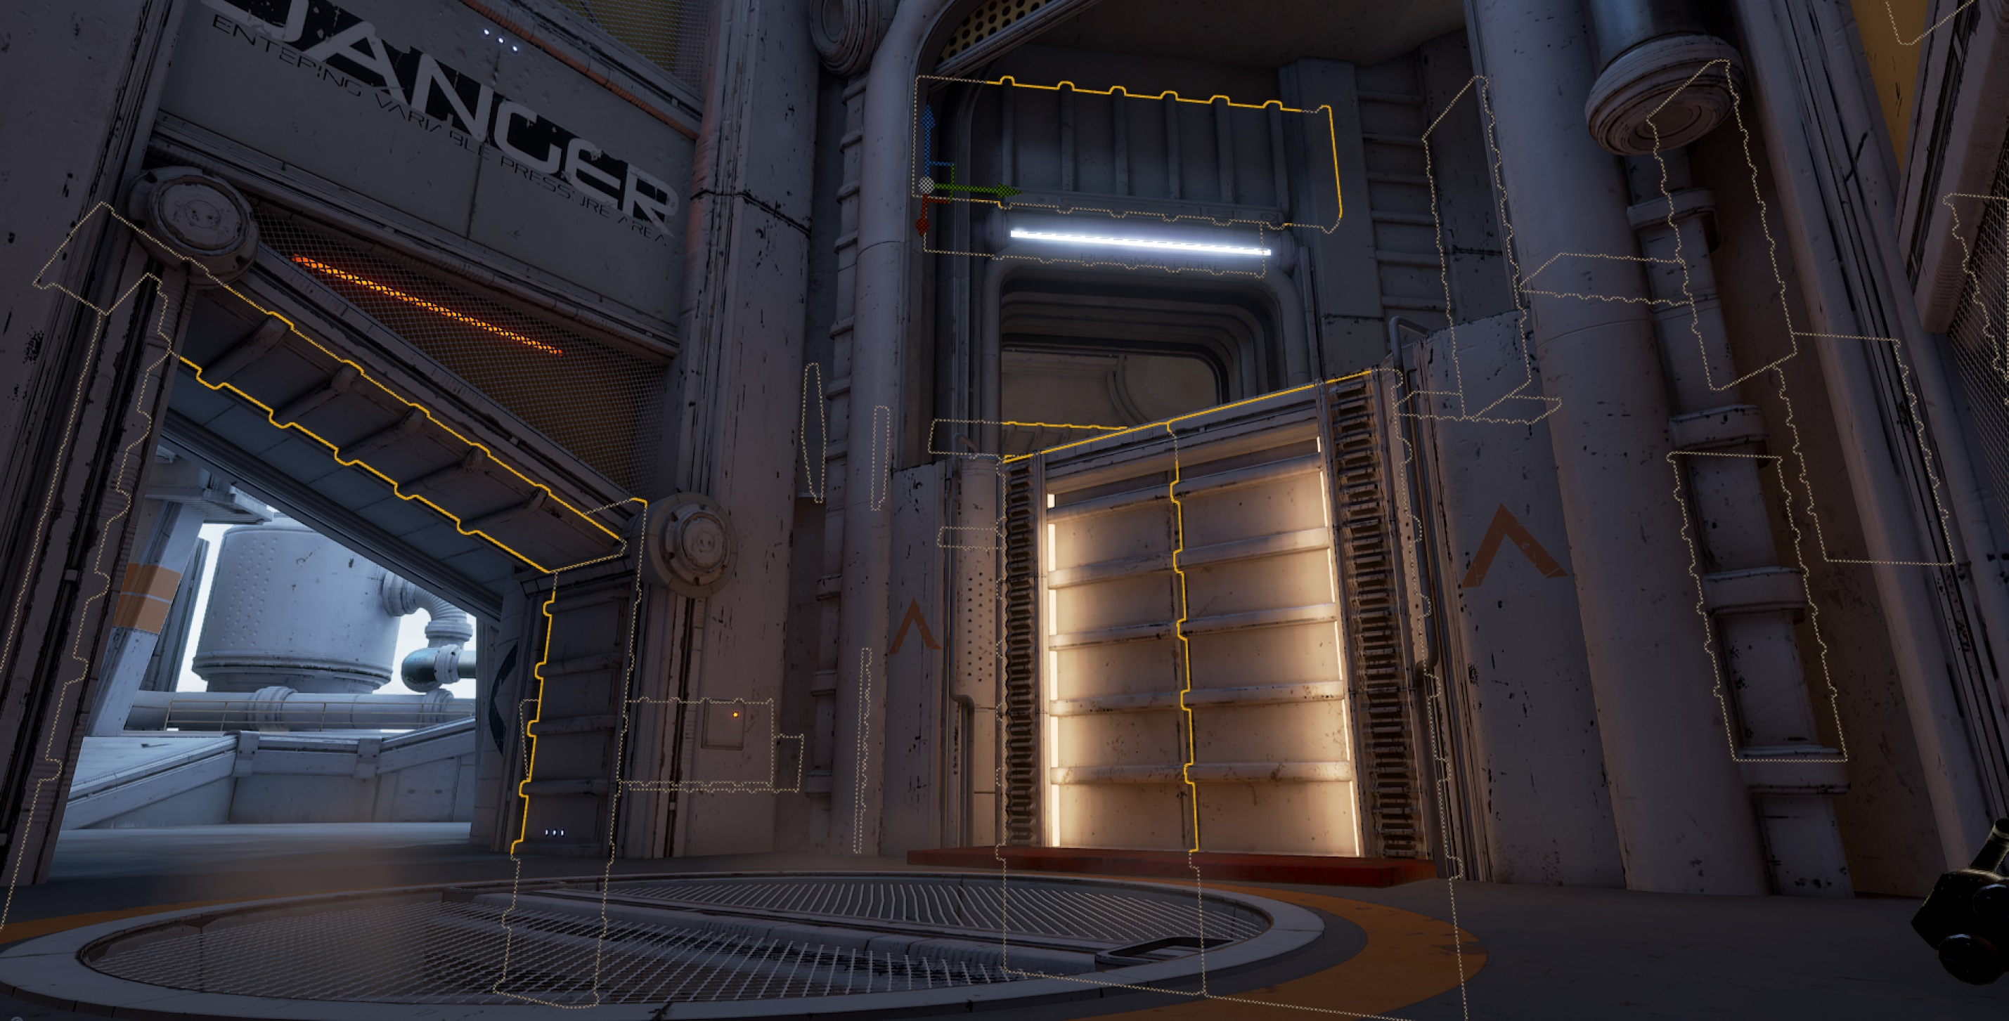
Asset Reuse
It’s common for 3D artists to develop environmental assets and remove backfaces where they don’t expect users to see them. By developing content that can be flipped and used from a variety of angles, you can keep memory usage down as the need for new assets to fill those angles—and all of the textures that come with the new assets—is reduced.

Slide 18
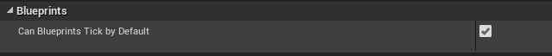
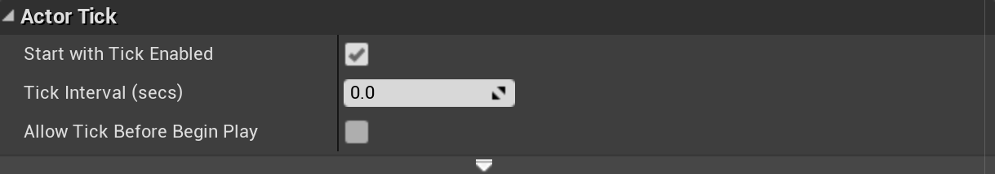
Blueprints ticking by default can be disabled in the Project Settings.
Overreliance on tick
By default, Ticks calculate every frame; however, Blueprints rarely need to tick by default.
Enable Actor Tick is set to True.
Alternatives to Tick:
Timelines
Timers
Manual toggling of Actor Tick on and off
Polling versus Event-driven systems (event dispatchers are often forgotten!)
Ticking can be disabled per Blueprint in the Blueprint Class Defaults.

Slide 19
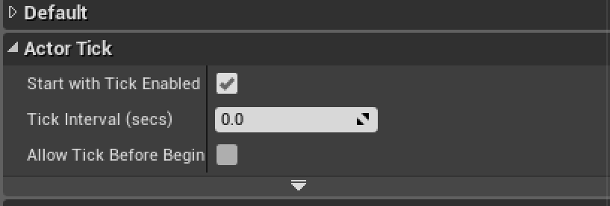
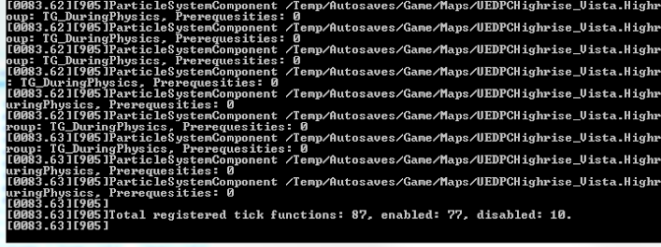
Ticking
Too many actors ticking can substantially slow down a project, and identifying these is important.
Use the dumpticks console command to see a list of all actors that are currently ticking.
Which of these could be driven by Events? Which by Timelines? Which Tick cycles only need to periodically be active?

Slide 20
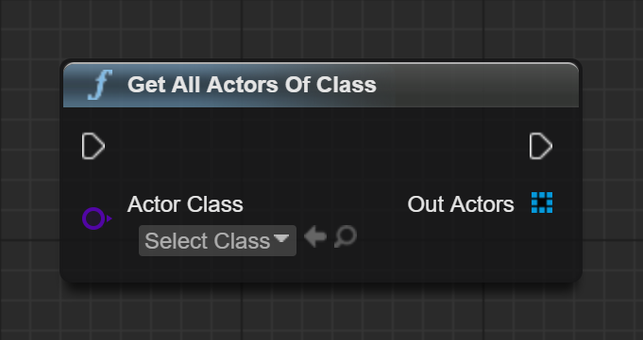
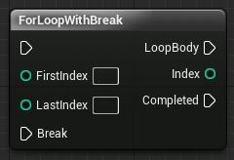
Functions like Get All Actors Of Class can wreak havoc on performance.
Expensive Functions
Expensive functions, particularly called from Blueprint, can cause the game thread to slow down and cause stuttering.
Can a result be cached and run intermittently?
Do the functions need to run every tick?
When running a loop, can it have an “early out” given certain conditions?
Can the processing of something be stretched over multiple ticks?
Can a Get All Actors Of Class be replaced with a function that only gets actors overlapped?
Should an animation always tick, or only when the character is being rendered?
For Loops can be expensive, especially when nested, so consider using breakable loops if iterations aren’t necessary after a result has been found.

Slide 21
Engine Class
Native Base Class
Blueprint Base Class
Blueprint Child Class 1
Blueprint Child Class 2
Blueprint Child Class 3
Other General Blueprint Optimizations
Avoid too many components in a single class, as they’re expensive to spawn.
The Math Expression node is optimized to speed things up and optimize expensive math nodes.
Consider having a Native base class to handle expensive functions.

Slide 22
Profiling
How to Identify What’s Going Wrong

Slide 23
Profiling Overview
In game development, we use the term “profiling” to refer to the process of analyzing the complexity, memory, or computational time it takes to execute tasks. When developing a project, it’s important to profile regularly in order to understand the overhead associated with art and new features as they’re added.
Profiling can be used to capture information that is causing bottlenecks or slowdowns in both the CPU and GPU.

Slide 24

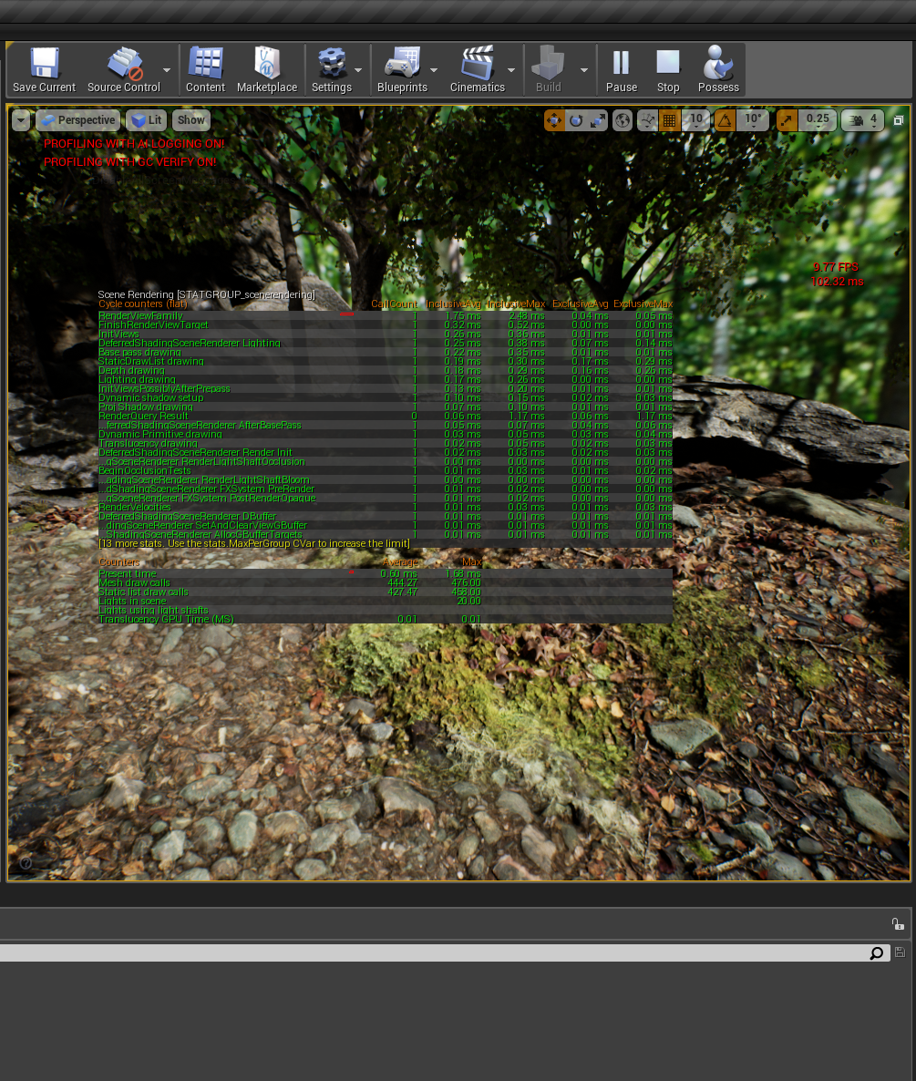
Stat FPS
Stat FPS displays an FPS counter on screen. Remember that t.MaxFPS can be used to raise the maximum FPS if it is currently capped at maximum.
Stat Unit
Stat Unit can be used to get Game, Draw, and GPU times. This can help determine if an issue is on the CPU or GPU.
Stat SceneRendering
Stat SceneRendering shows general rendering statistics. This is a good starting point for finding general areas of slow performance in the rendering process.
Stat RHI
Stat RHI displays stats for the Rendering Hardware Interface, which provides an overall capture of memory, triangles drawn, and draw calls.

Slide 25
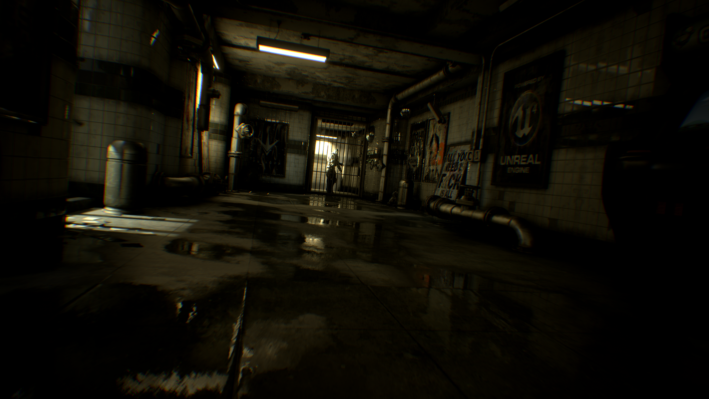
View modes
The Unreal Editor viewports have a large number of visualization modes to help you see the type of data being processed in your scene, as well as diagnose any errors or unexpected results. The more common view modes have their own hotkeys, but all can be accessed from the viewport within the View Mode menu.

Slide 26
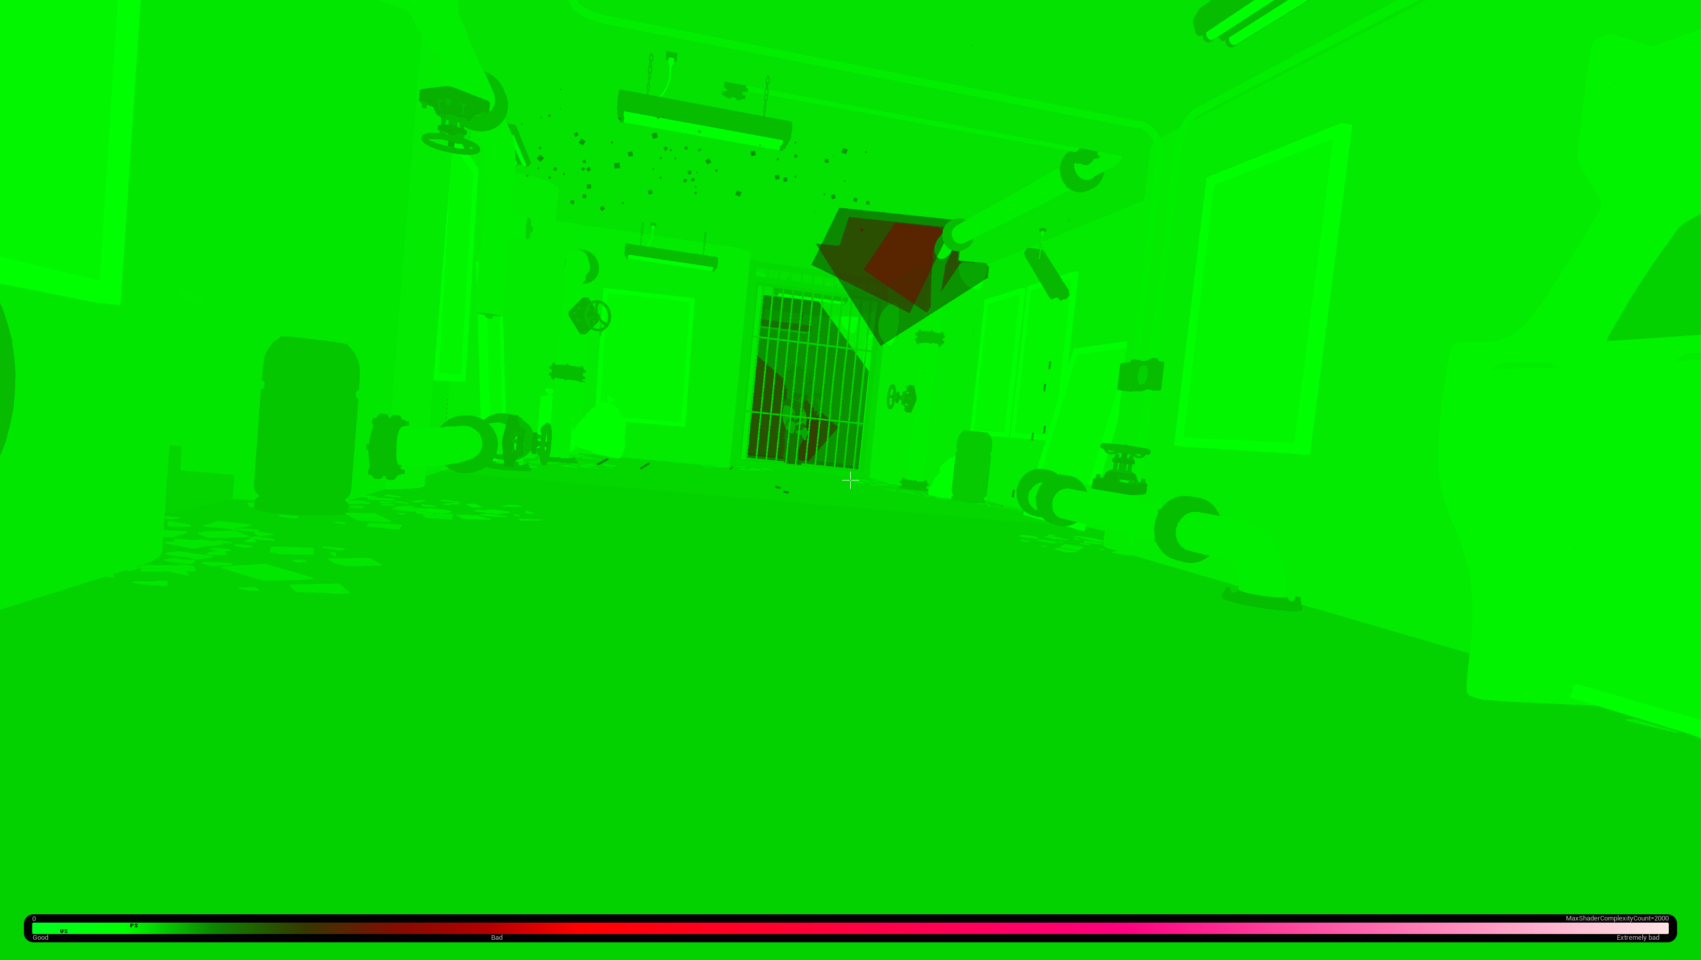
Shader complexity
The Shader Complexity mode is used to visualize the number of shader instructions being used to test the overall performance for your base scene as well as to optimize particle effects, which tend to cause performance spikes with a large amount of overdraw for a short period of time.
Only instruction count is used to calculate shader complexity, which may not always be accurate. For example, a shader with 16 instructions, all texture lookups, will be much slower on all platforms than a shader with 16 math instructions. Also, shaders that contain loops that are not unrolled will not be represented accurately by the instruction count; this is mainly an issue for vertex shaders. Overall, the instruction count is a good metric in the vast majority of cases.

Slide 27
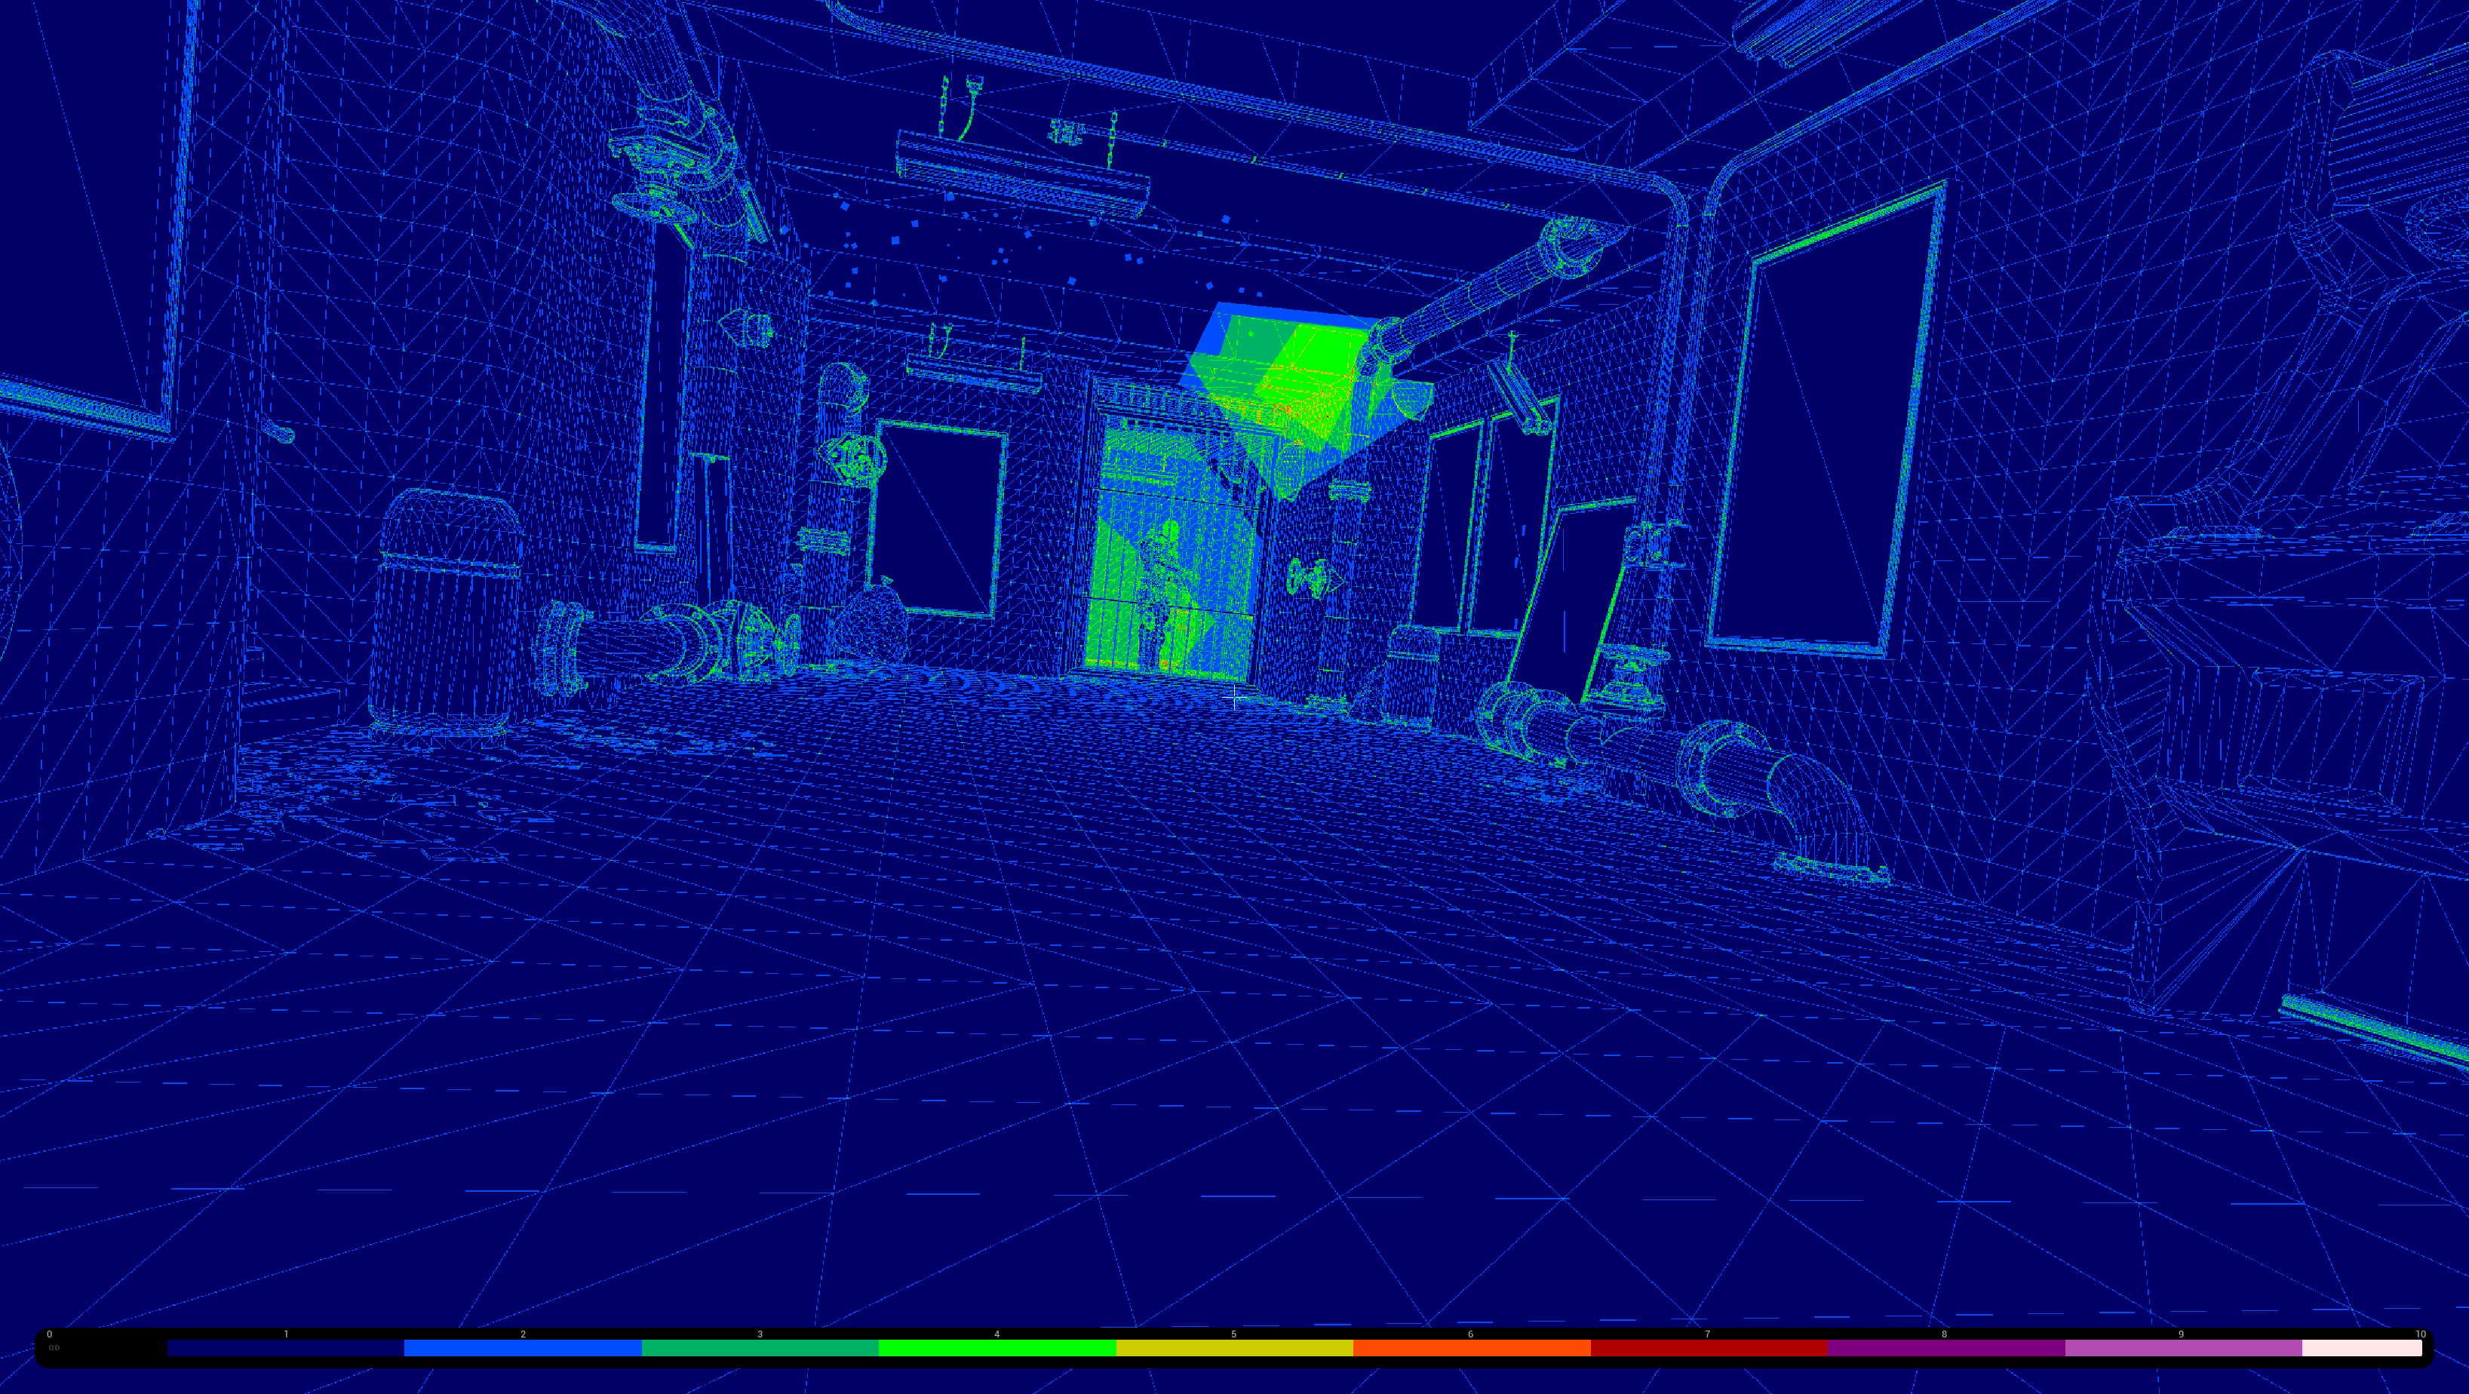
Quad Overdraw
All pixels are rendered in 2x2 quads. The Quad Overdraw view mode is used to illustrate how many times the GPU has to draw each quad. As vertices in a scene become more dense, their overdraw increases. When using techniques that cause larger scene samples, such as MSAA, it’s possible to substantially overdraw dense areas of vertices and create more overhead.

Slide 28
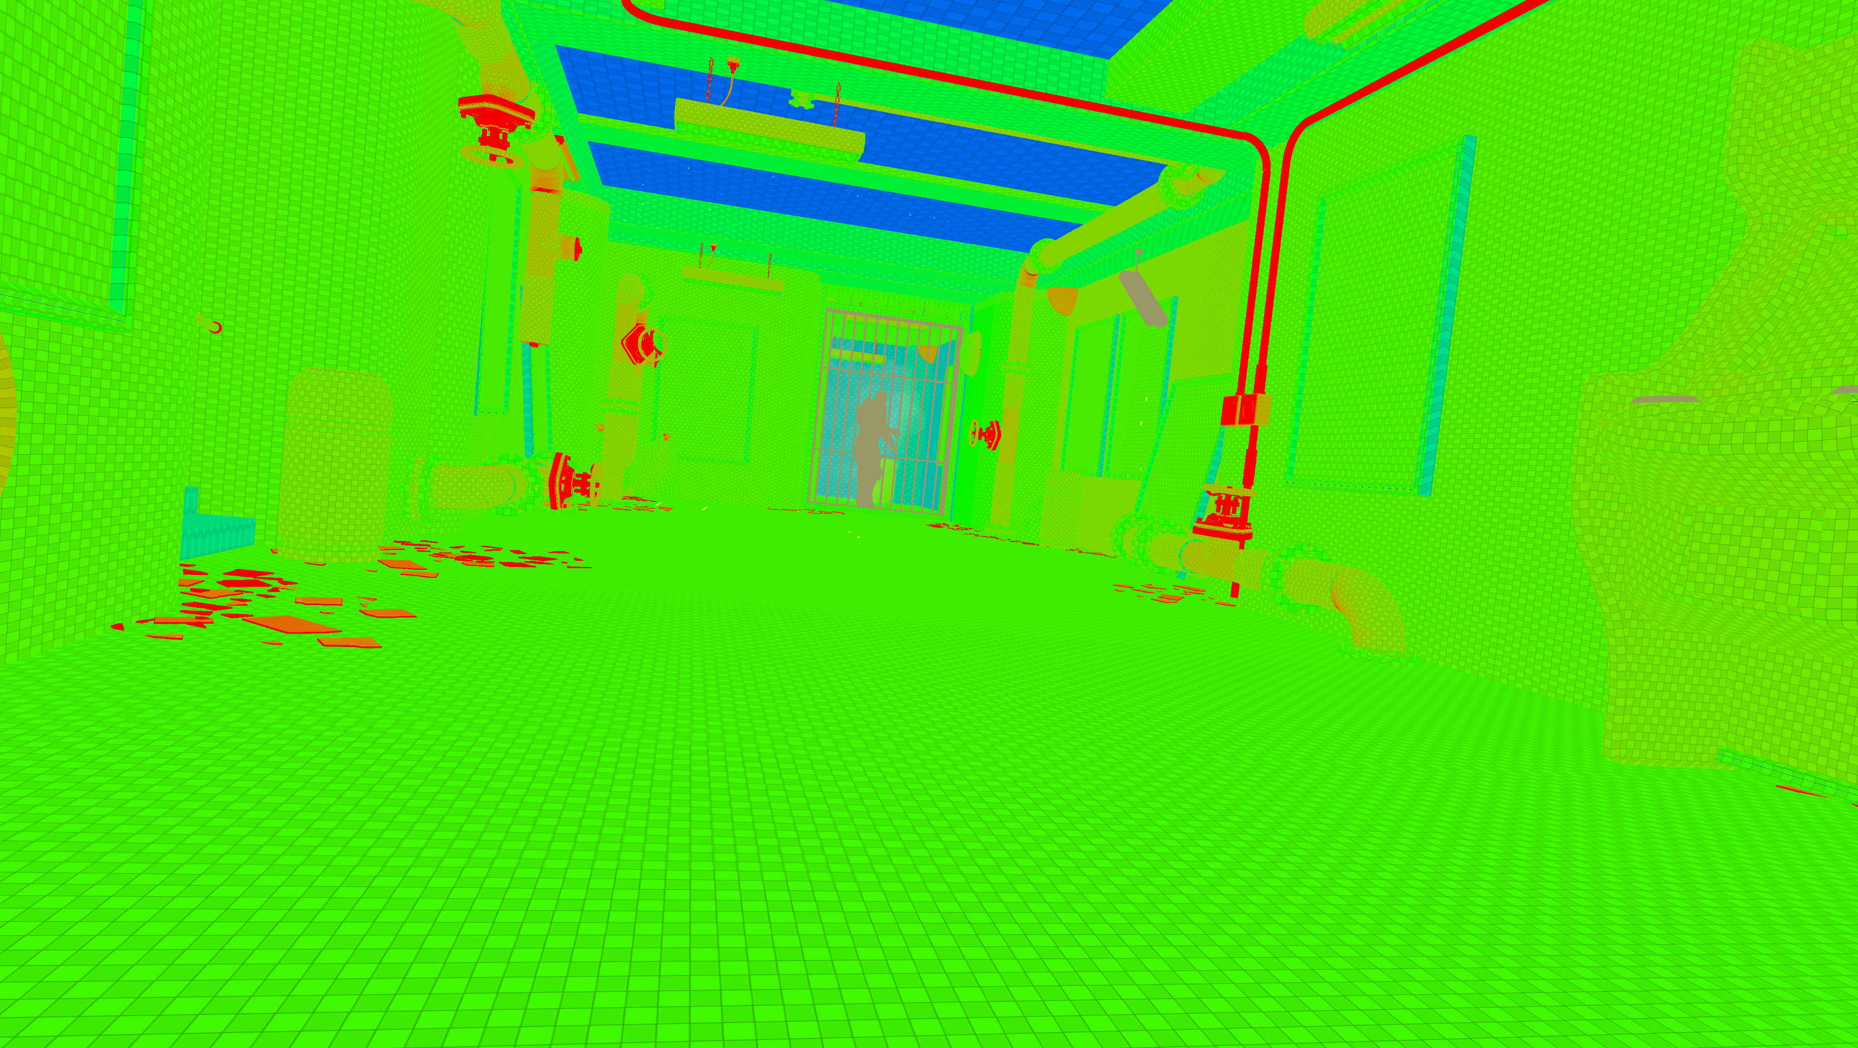
Lightmap Density
The Lightmap Density mode displays the lightmap density of objects that are texture mapped, color-coding them by their relation to an ideal/max density setting and displaying a grid that maps to the actual lightmap texels. It is important to have even texel density across your scene to get consistent lightmap lighting and avoid wasting texture memory.

Slide 29
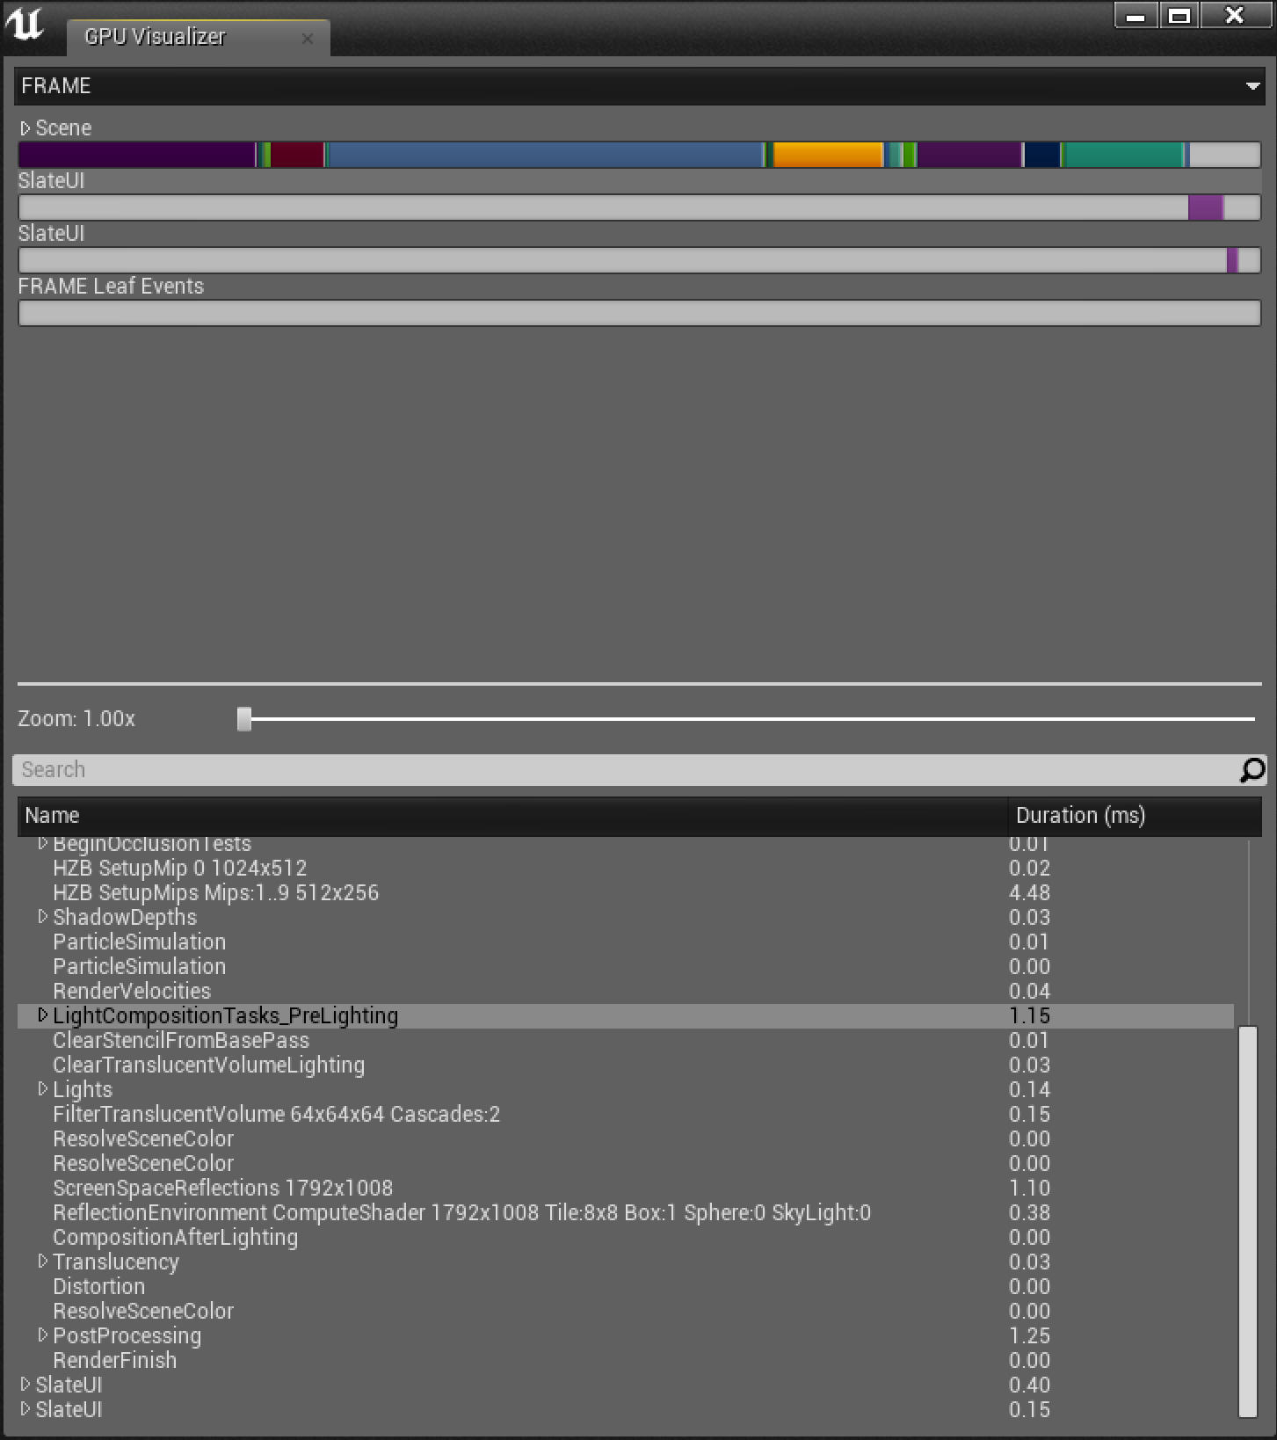
Profile GPU
The GPU has many units working in parallel, and it is common to be bound by different units for different parts of the frame. As a result, it makes sense to look at finding where the GPU cost is going when looking for the bottleneck and what a GPU bottleneck is.
The ProfileGPU command, also accessible via Ctrl + Shift + Comma, allows you to quickly identify the GPU cost of the various passes, sometimes down to the draw calls. The data is based on GPU timestamps and is usually quite accurate. Certain optimizations can make the numbers less reliable, and it is good to be critical of any number.

Slide 30
GPUs process both Pixels and Vertices, and sometimes it’s necessary to identify whether a bottleneck is caused by pixels or vertices in the scene. By using the r.SetRes and r.ScreenPercentage commands, the number of pixels being rendered can be scaled up or down.
If changing the resolution does not decrease the GPU time by much, the issue is likely vertex related. Following are typical causes and some solutions:
Too many triangles being rendered. (Use Level of Detail meshes.)
Complex World Position Offset / Displacement Material using Textures with poor MIP mapping. (Adjust the Material.)
Tessellation. (Avoid if possible or lower the tessellation factor if necessary.)
Many UV or Normal seams that result in more vertices
Too many vertex attributes (extra UV channels)
High vertex count. (Verify the vertex count is reasonable; some importer code might not have welded the vertices. Combine vertices that have the same position, UV, and normal.)
Less often, you are bound by something else, possibly one of the following:
Object cost (more likely a CPU-related cost, but there might be some GPU cost)
Triangle setup cost (very high poly meshes with a cheap vertex shader, such as shadow map static meshes; rarely the issue)
Use of level of detail (LOD) meshes
View cost (for example, HZB occlusion culling)
Scene cost (for example, GPU particle simulation)
Pixels aren’t always the problem.

Slide 31
Debugging
Isolating Code Issues

Slide 32
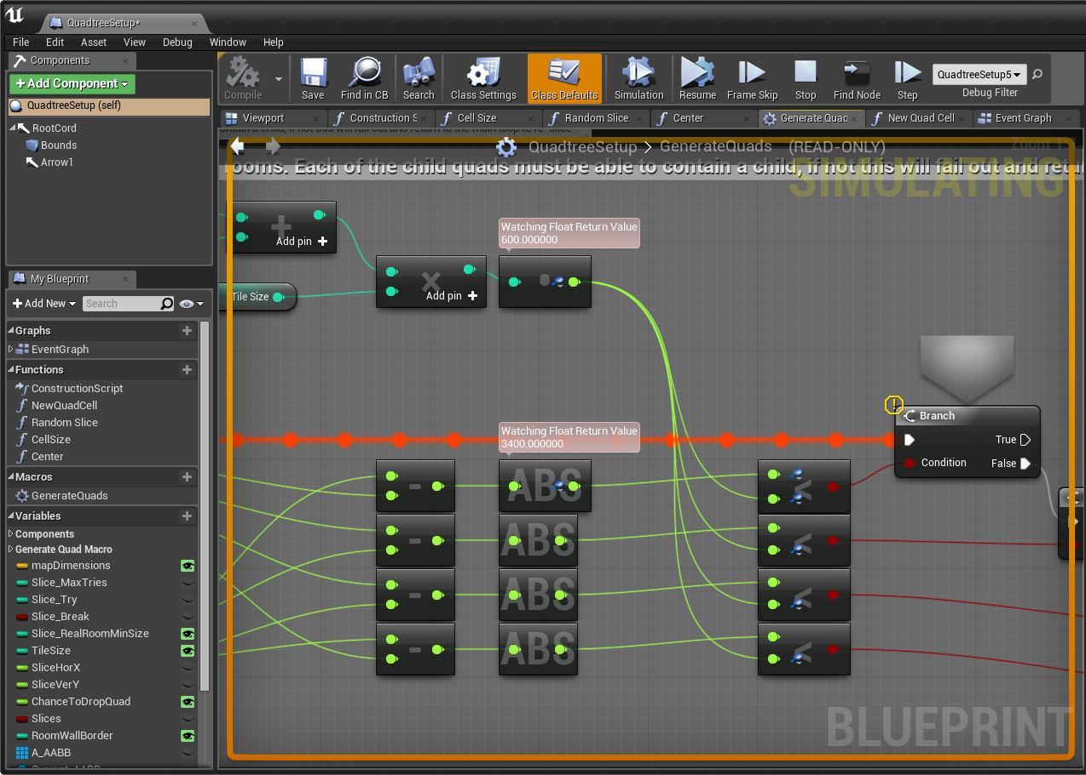
Debugging Basics
Debugging refers to the process of tracking down and fixing defects that prevent the game from operating correctly. Such defects, also knows as bugs, can be found in nearly every aspect of a game, including code, 3D or 2D assets, materials, and so on.
To debug code, both native and Blueprint, you employ the use of a tool called a Debugger. Debuggers allow you to pause the execution of the game and walk through it step by step, inspecting values of properties along the way.

Slide 33
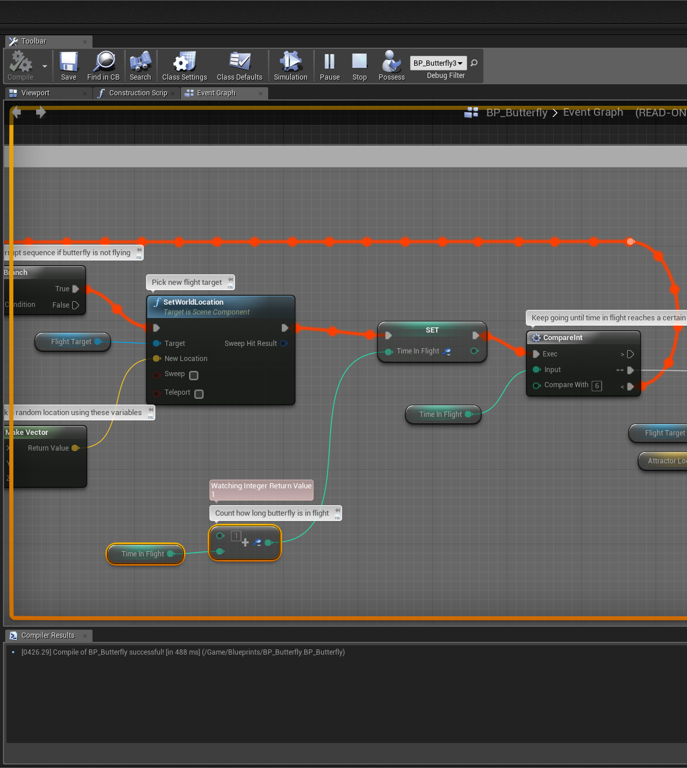
Inspecting Values
Setting a breakpoint allows execution of the game to be paused at a certain point while the game is running. Having the ability to pause the execution of the game and inspect any aspect of the game is an incredibly powerful and invaluable tool.
After a breakpoint has been hit, and the execution is halted, the debugger can also be used to inspect values of properties at this particular point in the game. This feature can be used to verify that values are what they are expected to be, allowing you to confirm whether or not your processes are working correctly.

Slide 34
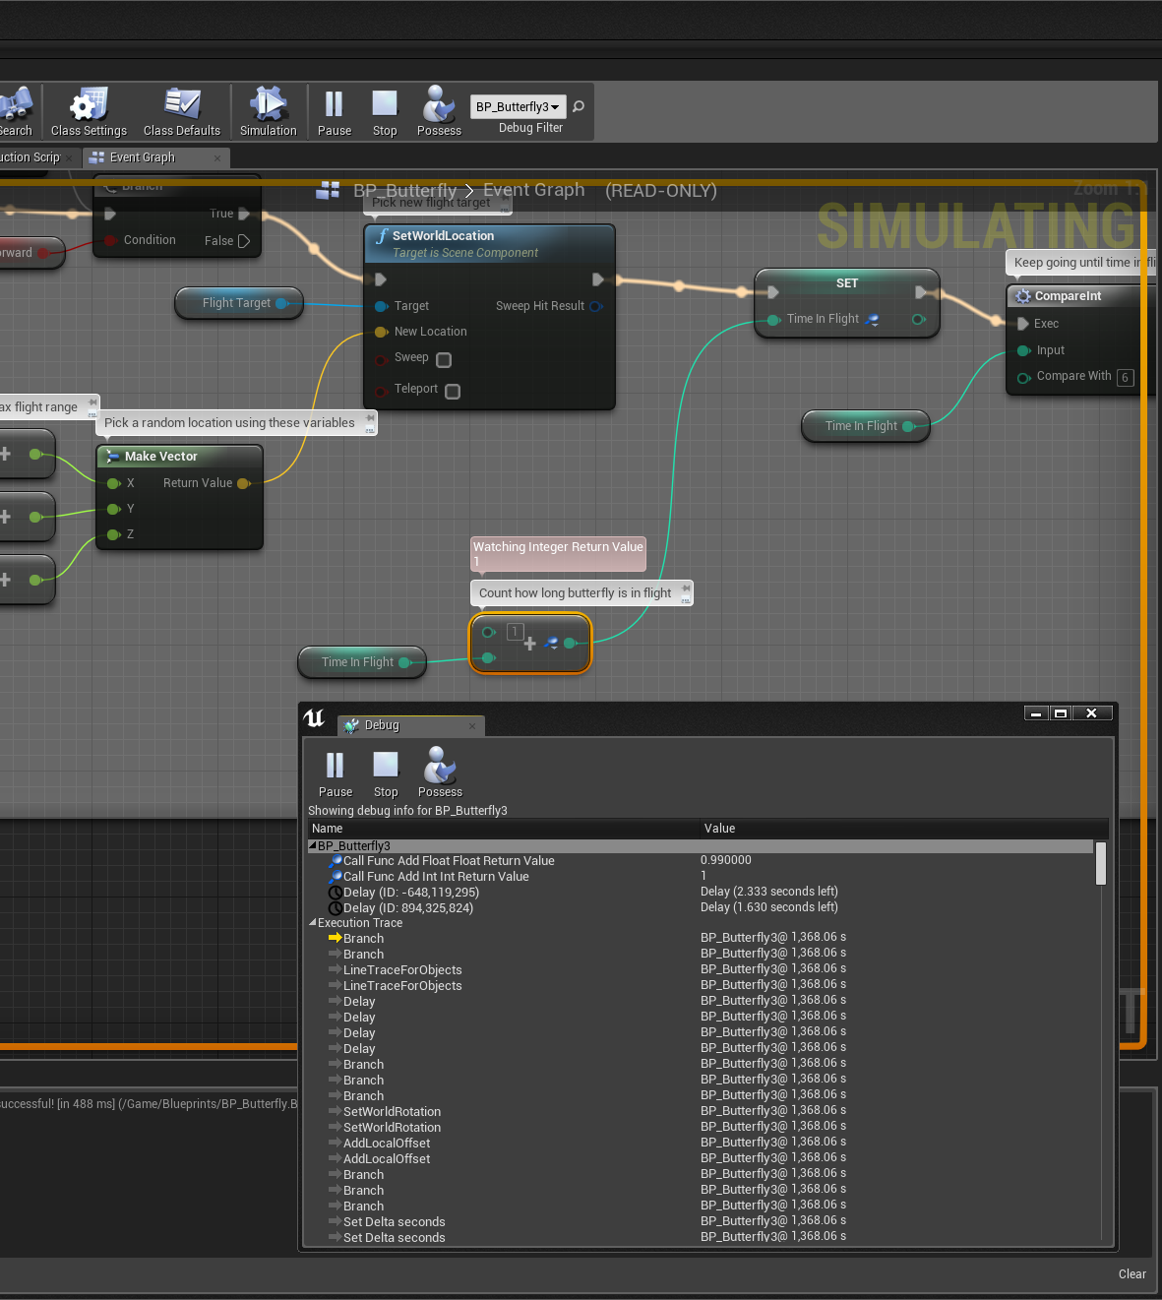
Call Stacks
Just as you are able to use the debugger to inspect properties, you are also able to inspect the flow of functions using the call stack or execution stack. This shows you the name and the order of functions that are in the process of being executed at the time that the execution has been paused. Being able to see where other functions are being called from can be essential to tracking down the cause of defects.

Slide 35
Conclusion
Questions?

